Slide 1
Clustering Algorithms
Part -1

Slide 2
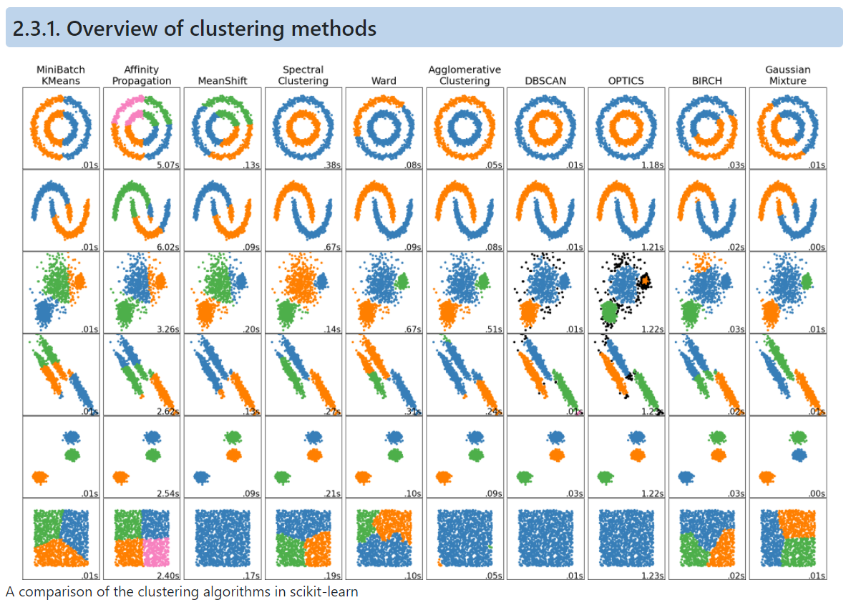
Overview

Slide 3
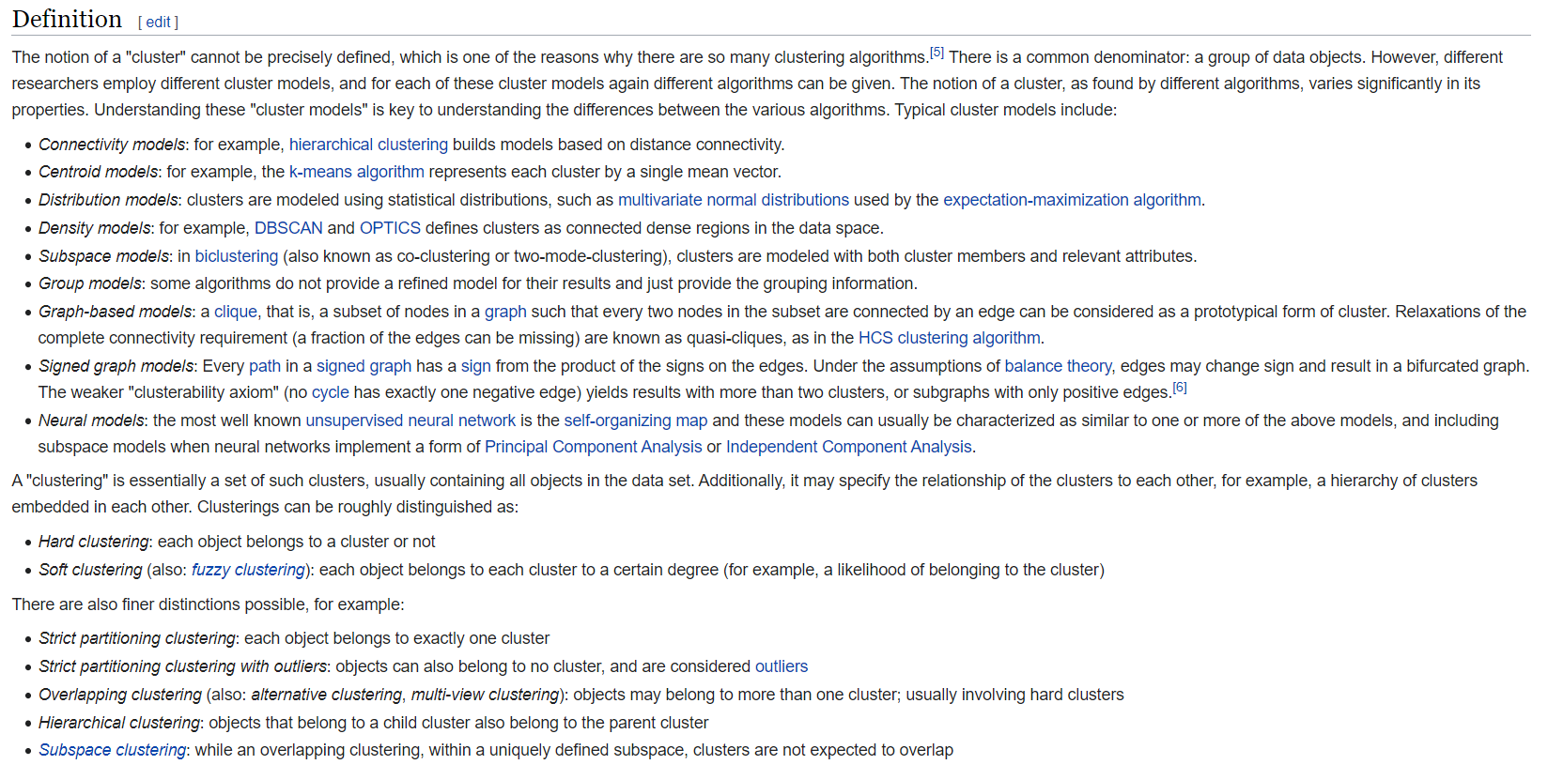
What is clustering

Slide 4
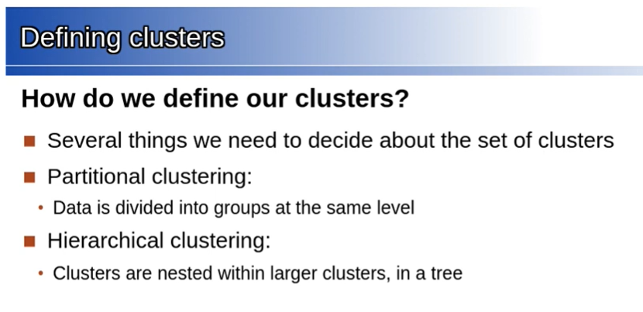
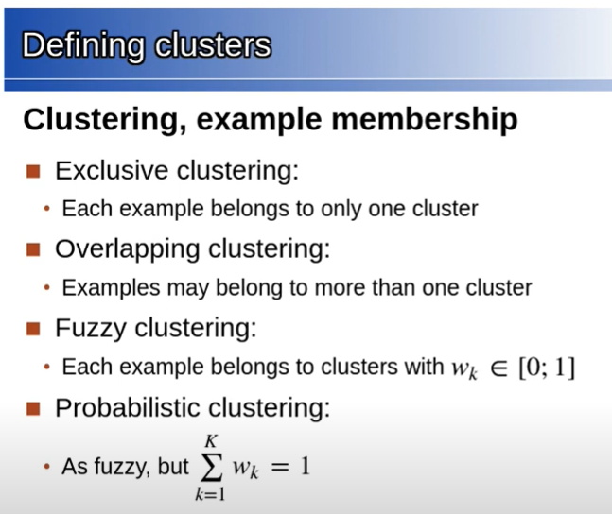
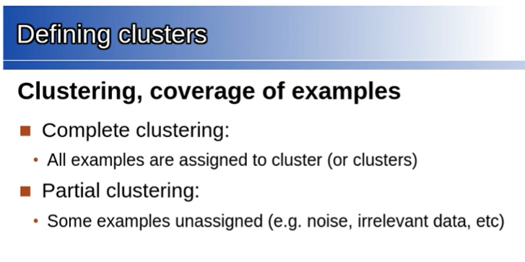

Slide 5
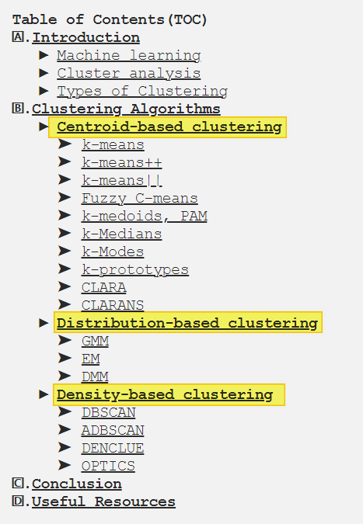
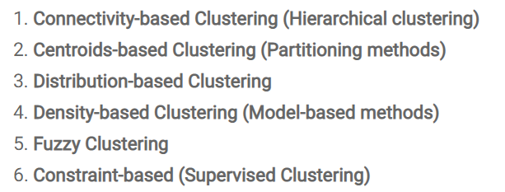
https://www.analytixlabs.co.in/blog/types-of-clustering-algorithms/#sub2
https://towardsdatascience.com/17-clustering-algorithms-used-in-data-science-mining-49dbfa5bf69a#9136

Slide 7
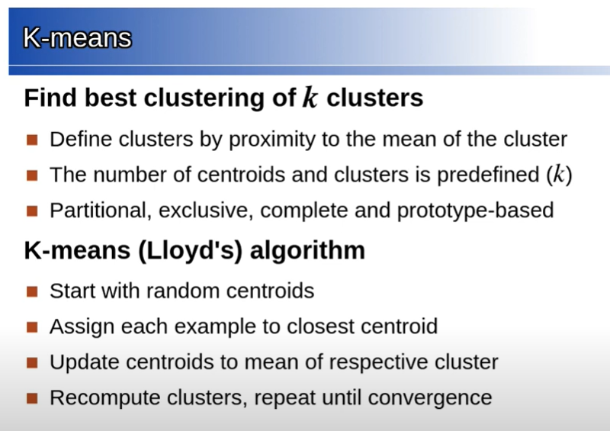
K-Means (Lloyd’s) Algorithm
Two ways to initialize the centroids –
Choose k random points from the available data points
Assign each point to a random cluster partition (one of k partitions) and then choose the centroid from them
K-Means++ -
https://www.coursera.org/lecture/ml-clustering-and-retrieval/smart-initialization-via-k-means-T9ZaG
Used to initialize K-Means cluster centroid.
K means is sensitive to cluster center initialization
How to choose K ? – Elbow method
https://www.coursera.org/learn/machine-learning/lecture/Ks0E9/choosing-the-number-of-clusters
How well the clustering has performed? - https://en.wikipedia.org/wiki/Silhouette_(clustering)
https://towardsdatascience.com/k-means-clustering-algorithm-applications-evaluation-methods-and-drawbacks-aa03e644b48a

Slide 8
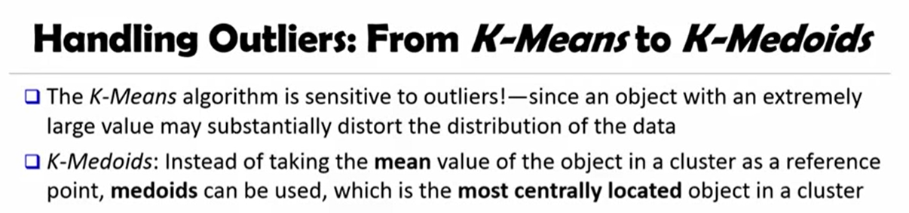
K-Mediods
It is the same problem as Mean has to Median in Arithmetic
Taking Mean is sensitive to outliers
Median will just take the middle value. This is analogous to K-Medoids where, rather than finding the centroid of the cluster by taking the mean, it tries to find by identifying the most centrally located data point in the cluster
https://www.youtube.com/watch?v=GApaAnGx3Fw

Slide 9
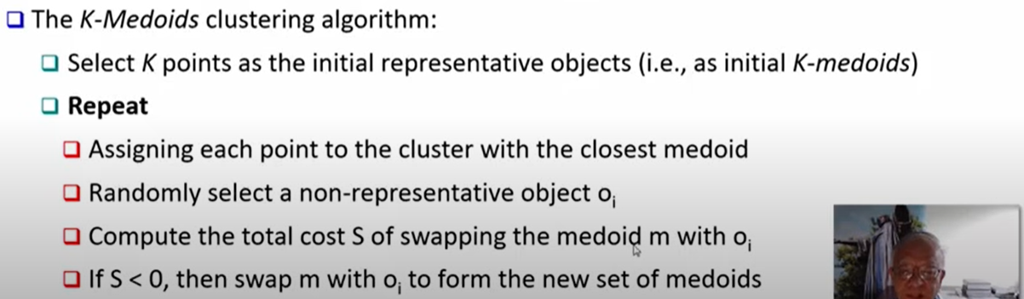
K-Mediods

Slide 10
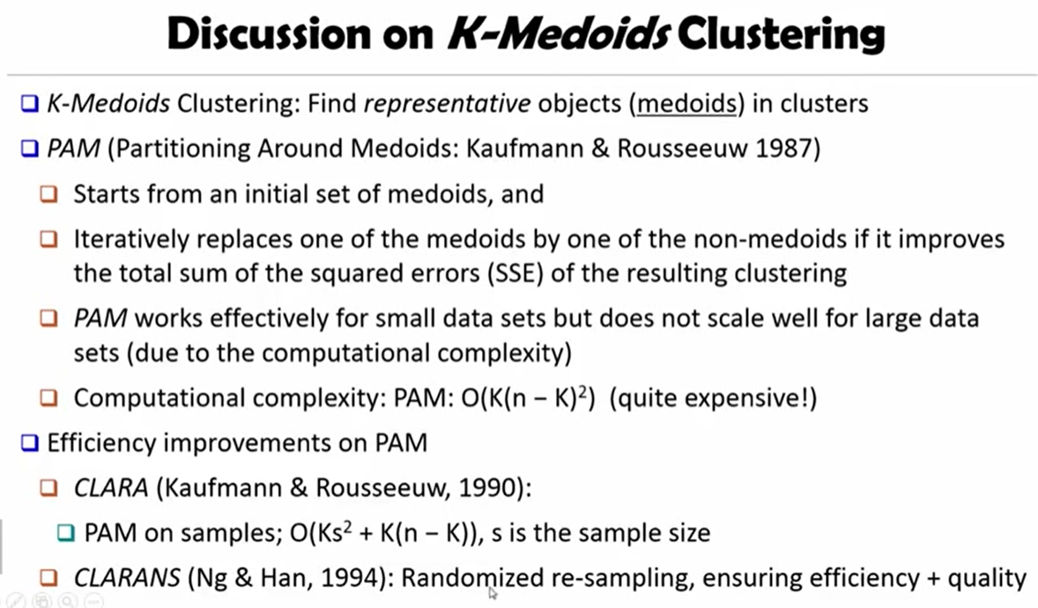
K-Mediods

Slide 11
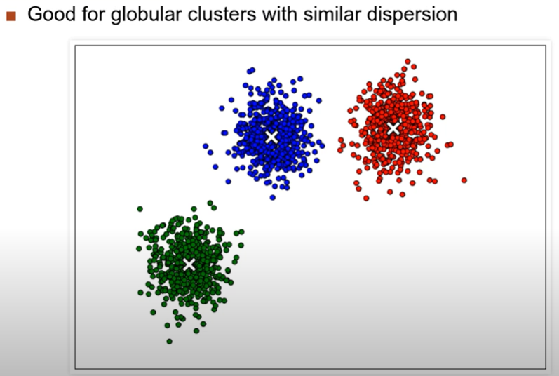
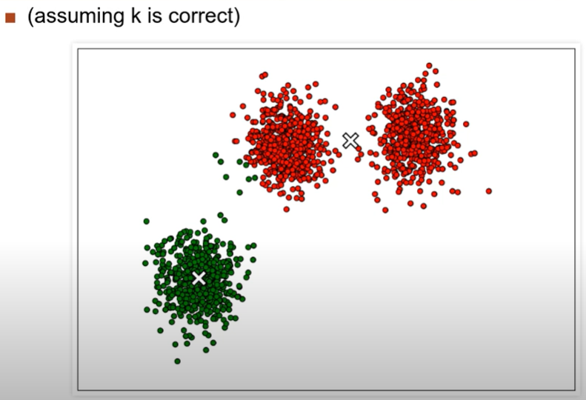
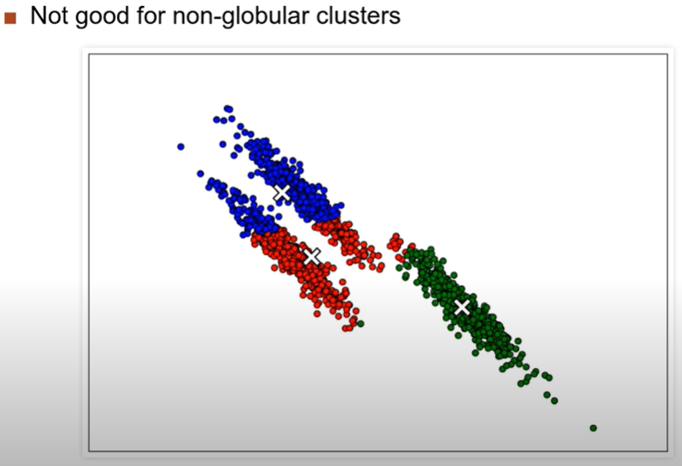
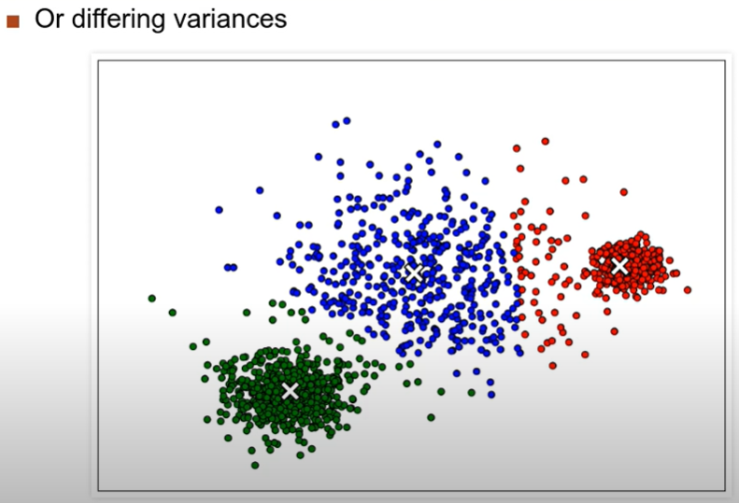
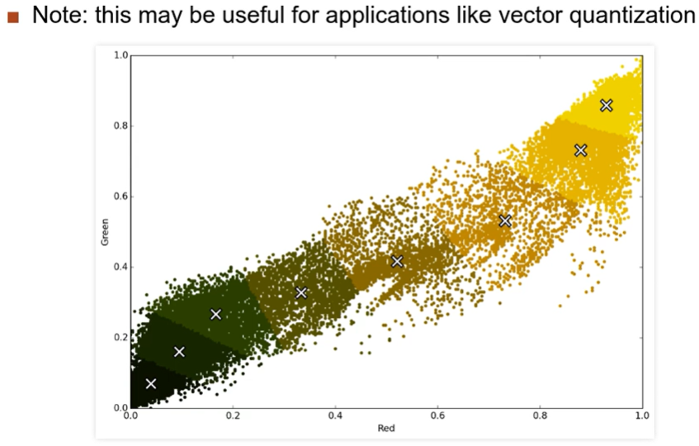
Problems with K-means | Advantages (Vector Quanta)
K-Means Clustering is not a free lunch
https://stats.stackexchange.com/questions/133656/how-to-understand-the-drawbacks-of-k-means/133694#133694
http://varianceexplained.org/r/kmeans-free-lunch/

Slide 12
Summary
Covered Centroid Based Clustering a.k.a Prototype based clustering –
K-Means
K-Means++ : method for initializing the cluster centroids
K-Medoids
PAM
CLARA
CLARANS
K-Median - (123) Partition Based Clustering 05 - The K Medians and K Modes Clustering Methods – YouTube
K-Mode - (123) Partition Based Clustering 05 - The K Medians and K Modes Clustering Methods - YouTube
https://towardsdatascience.com/10-tips-for-choosing-the-optimal-number-of-clusters-277e93d72d92 - Choosing optimal number of clusters

Slide 13
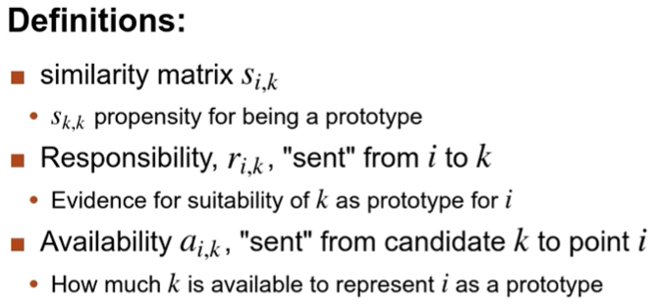
Affinity Propogation

Slide 14
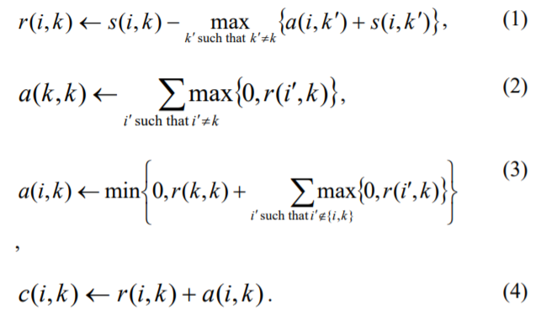
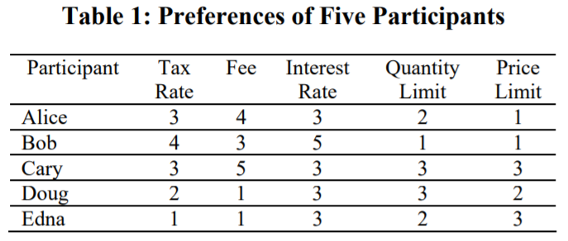
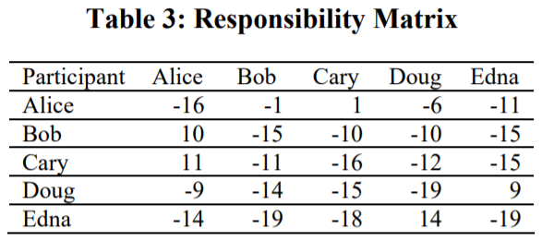
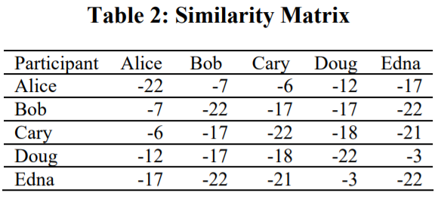
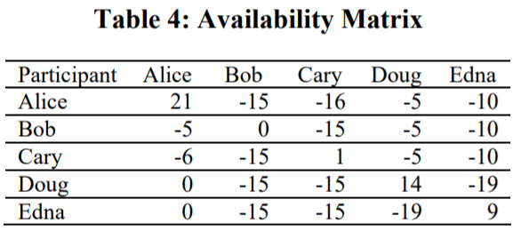
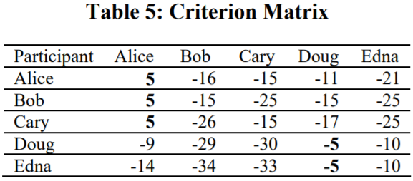
Working of Affinity Propogation
http://citeseerx.ist.psu.edu/viewdoc/download?doi=10.1.1.490.7628&rep=rep1&type=pdf

Slide 15
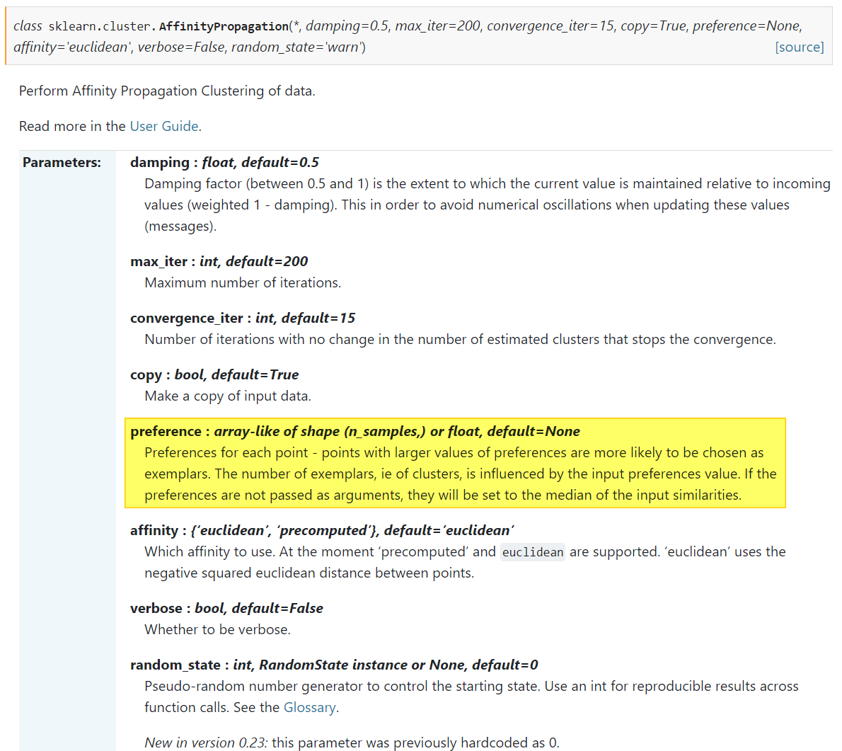
Add gifs from this site
https://www.ritchievink.com/blog/2018/05/18/algorithm-breakdown-affinity-propagation/
https://scikit-learn.org/stable/modules/generated/sklearn.cluster.AffinityPropagation.html

Slide 16
Advantages and Disadvantages
Again a centroid based method, but the centroid is determined by collective data points
The number of cluster need not be given at beginning

Slide 17
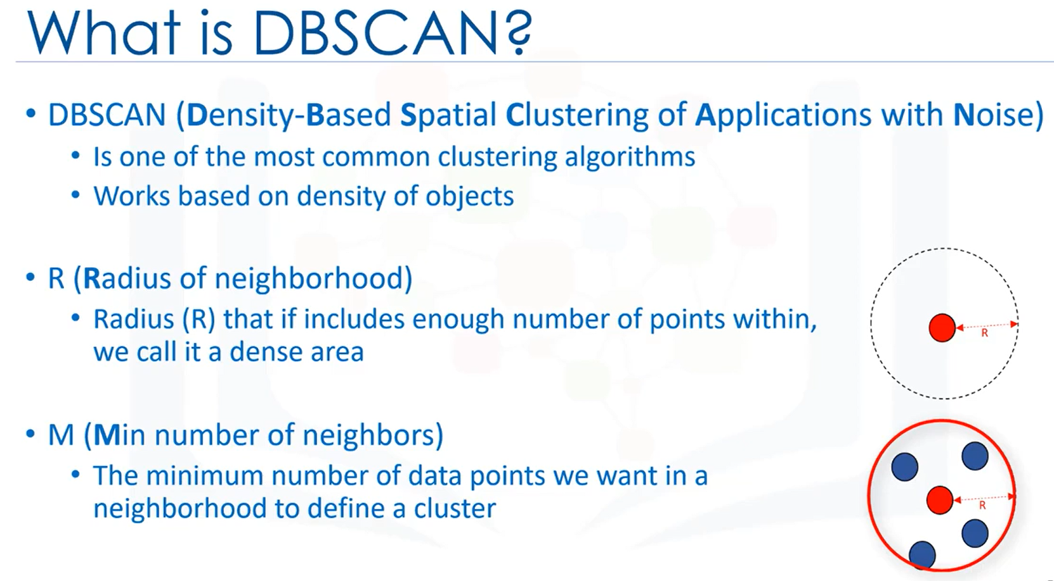
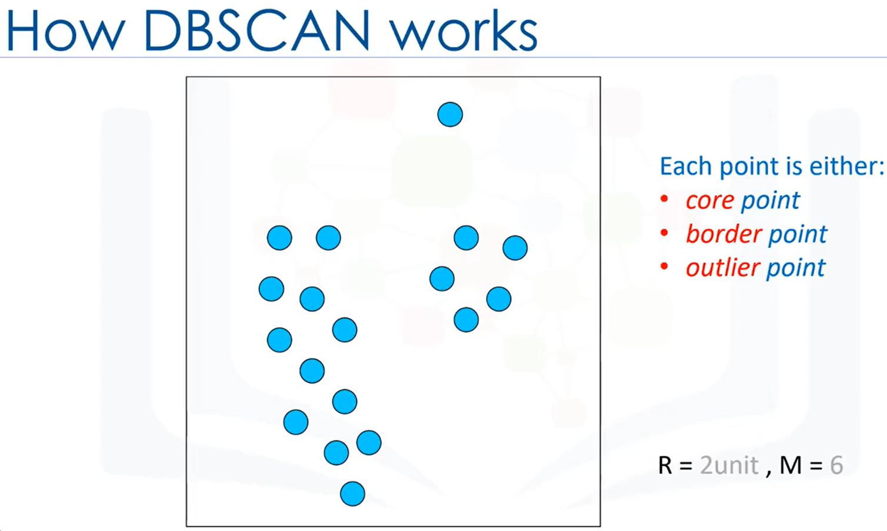
Density Based Spatial Clustering of Applications with Noise
https://www.youtube.com/watch?v=6jl9KkmgDIw

Slide 18
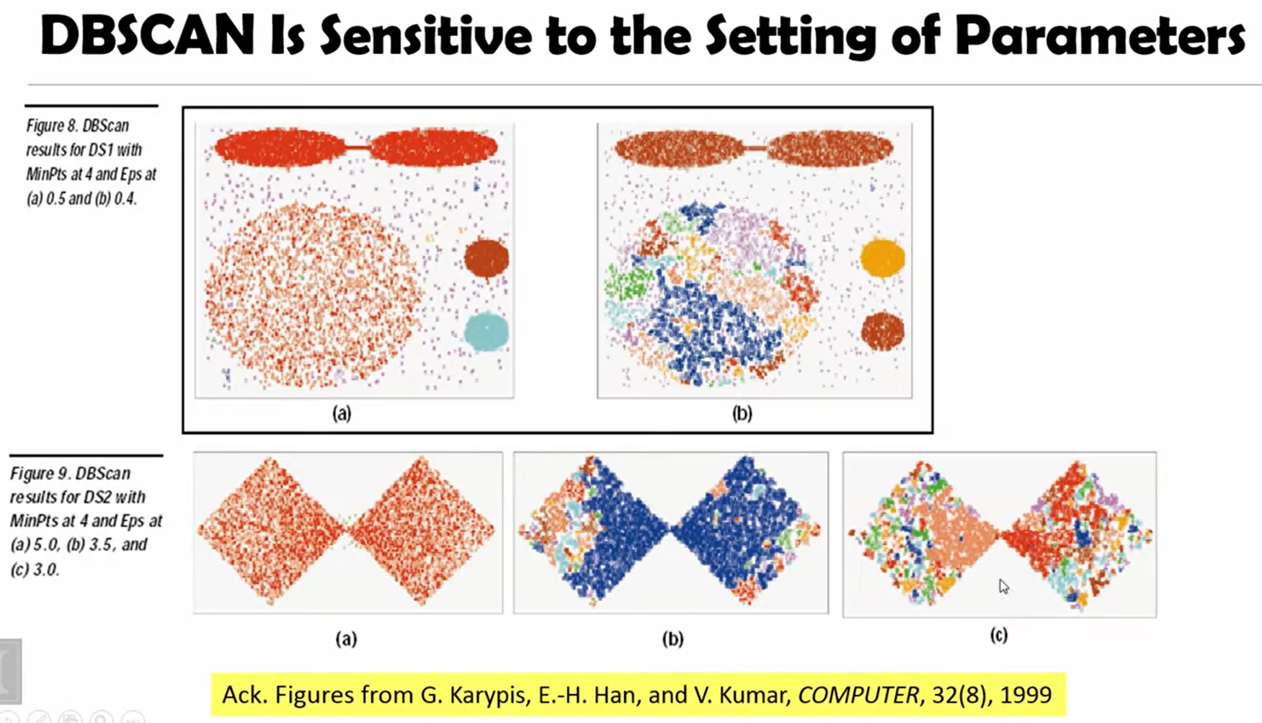
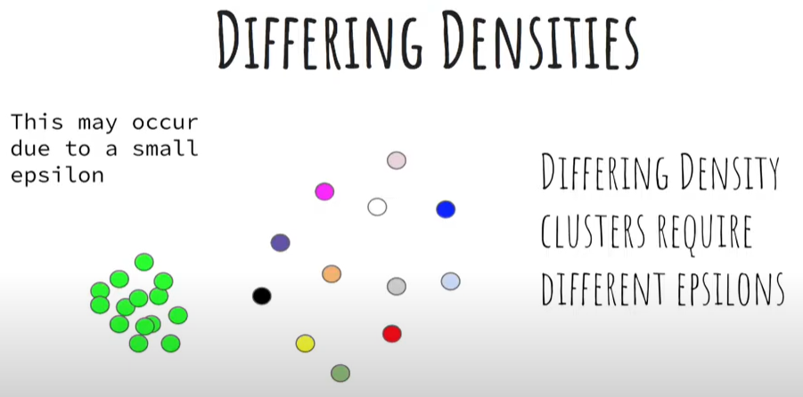
Disadvantage
Doesn’t handle different density clusters very well
https://www.youtube.com/watch?v=sKRUfsc8zp4
Doesn’t work well in high dimensionality
DBSCAN is not entirely deterministic. That's because the algorithm starts with a random point. Therefore, border points that are reachable from more than one cluster can be part of either cluster.
Good Read about advantages, disadvantages and extensions to DBSCAN - https://en.wikipedia.org/wiki/DBSCAN
https://www.youtube.com/watch?v=0Os5AydChR0

Slide 19
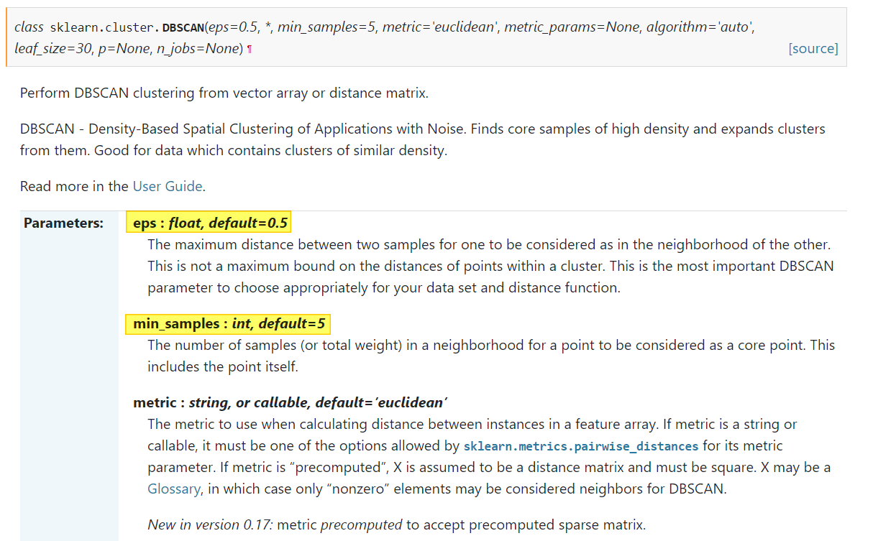
DBSCAN API – sklearn
https://scikit-learn.org/stable/modules/generated/sklearn.cluster.DBSCAN.html

Slide 20
Tools
https://www.naftaliharris.com/blog/visualizing-dbscan-clustering/
https://dashee87.github.io/data%20science/general/Clustering-with-Scikit-with-GIFs/

Slide 21
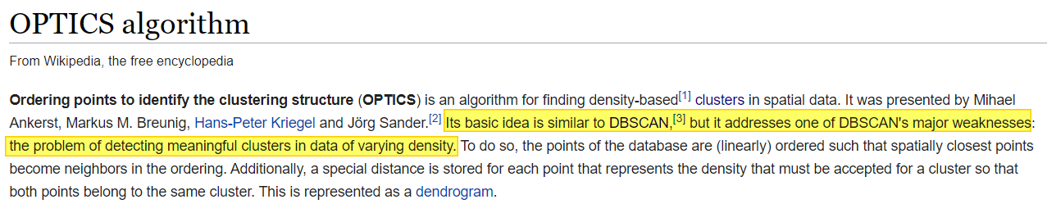
Ordering Points to Identify the Clustering Structure (OPTICS)
https://www.youtube.com/watch?v=GCnsmjwV3BE&list=RDQM5kYy1aM6fgE&start_radio=1

Slide 22
HDBSCAN
https://www.youtube.com/watch?v=AgPQ76RIi6A – Scipy2016
HDBSCAN, Fast Density Based Clustering, the How and the Why - John Healy – PyData 2018
https://hdbscan.readthedocs.io/en/latest/how_hdbscan_works.html - How HDBSCAN Works
https://towardsdatascience.com/a-gentle-introduction-to-hdbscan-and-density-based-clustering-5fd79329c1e8

Slide 23
K-Nearest Neighbours

Slide 24
Agglomerative Clustering (Hierarchical Clustering)
Lecture 59 — Hierarchical Clustering | Stanford University
Hierarchical Clustering Playlist - Victor Lavrenko

Slide 25
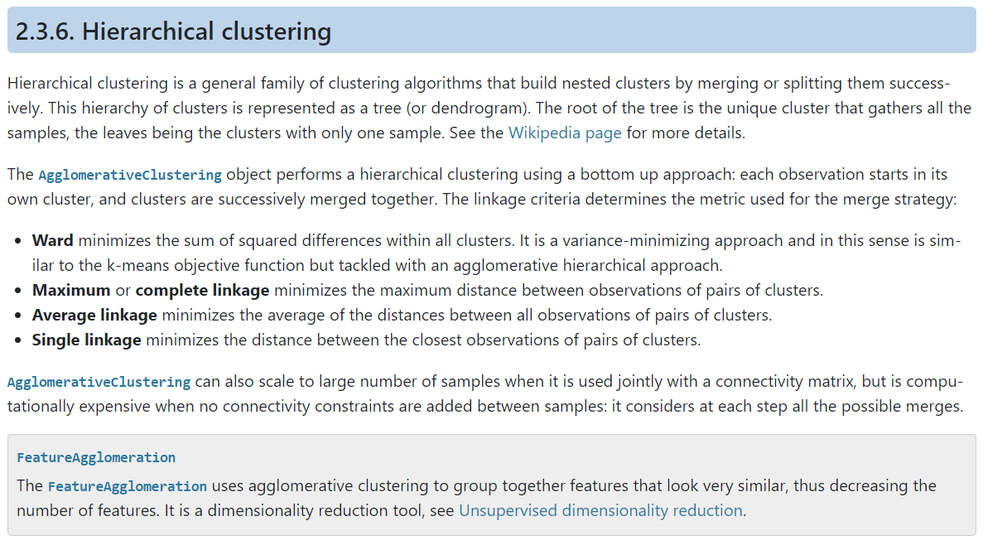
Agglomerative Clustering (Hierarchical Clustering)
Lecture 59 — Hierarchical Clustering | Stanford University
Hierarchical Clustering Playlist - Victor Lavrenko
https://scikit-learn.org/stable/modules/clustering.html#hierarchical-clustering

Slide 26
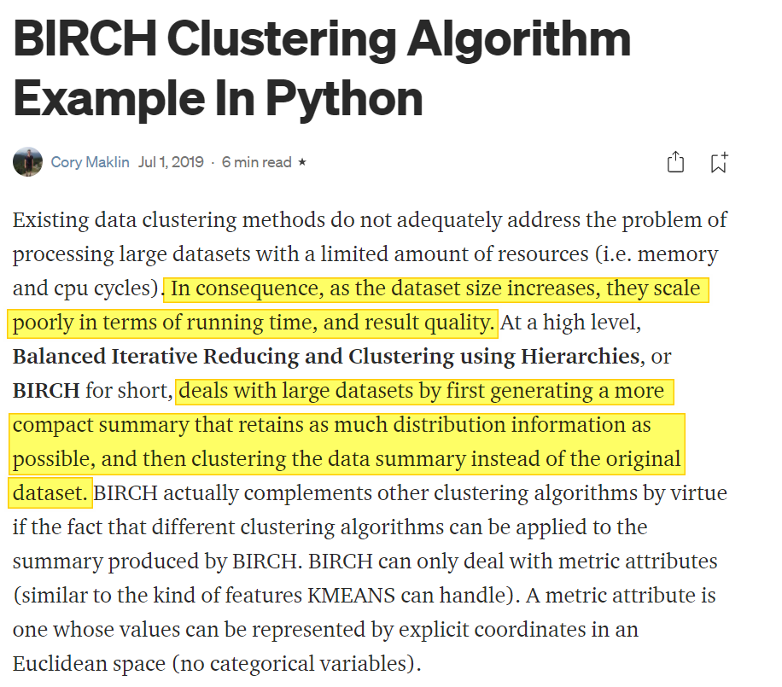
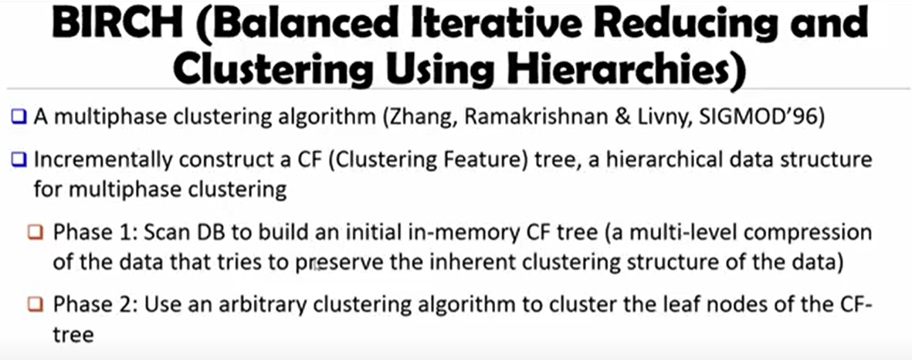
BRICH - Balanced Iterative Reducing and Clustering using Hierarchies
https://www.youtube.com/watch?v=xw3RwYs7fUM
https://towardsdatascience.com/machine-learning-birch-clustering-algorithm-clearly-explained-fb9838cbeed9

Slide 27
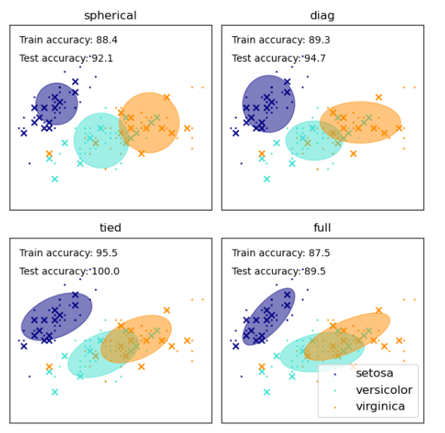
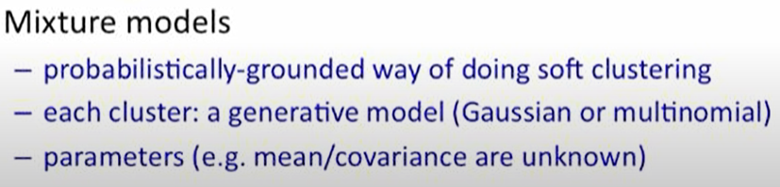
Gaussian Mixture Models
Notice the overlap in the clusters
Mixture Models - Victor Lavrenko

Slide 28
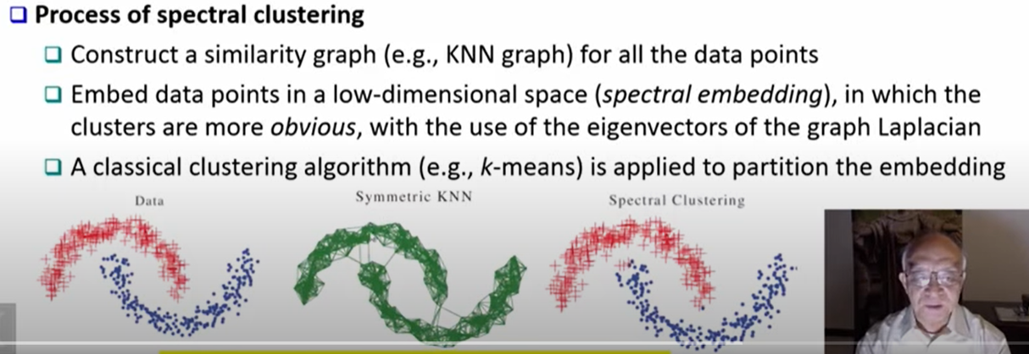
Spectral Clustering
https://www.youtube.com/watch?v=zkgm0i77jQ8 – Illinois prof
https://www.youtube.com/watch?v=siCPjpUtE0A&list=PLLssT5z_DsK9JDLcT8T62VtzwyW9LNepV&index=34 – Mining of Massive datasets

Slide 29
Mean-Shift Algorithm
https://www.youtube.com/playlist?list=PLgRmnYJpeyF0E075R80GSkZpuwyJjBXIt – Mean Shift Udacity

Slide 30
Clustering in Higher Dimensions
Curse of Dimentionality

Slide 31
Evaluation
https://www.youtube.com/watch?v=Mf6MqIS2ql4 – Accessing quality of clustering

Slide 32
How to handle Categorical Data?

Slide 33
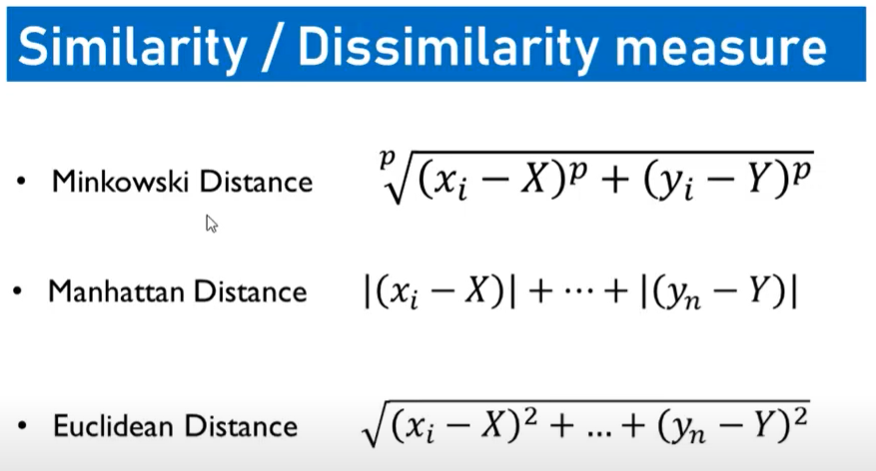
Similarity
https://en.wikipedia.org/wiki/Self-organizing_map
https://www.baeldung.com/cs/euclidean-distance-vs-cosine-similarity
https://machinelearningmastery.com/distance-measures-for-machine-learning/
https://statisticaloddsandends.wordpress.com/2018/12/21/medians-in-high-dimensions/ - Median in multi dimensions
https://medium.com/analytics-vidhya/gowers-distance-899f9c4bd553 - Grower’s distance
Unsupervised extra trees dissimilarity (UET) - https://hal.inria.fr/hal-01982232/document
https://stats.stackexchange.com/questions/80377/which-distance-to-use-e-g-manhattan-euclidean-bray-curtis-etc - which distance metric to be used

Slide 34
